Slide 1


Unit 5
Listen, chant and match
page(36-37)

Slide 2
Students Will be able to ...
Recognize the animals' names.
Identify the weathers.

Slide 3


Review
Use (this / these)
......... are our comics books.
Whose comics book is …....?
Use A/An:
…...cat.
….....girl.
these
this
an
a

Slide 4

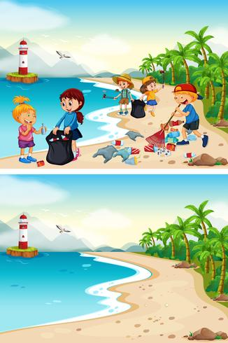
Discover the mistake

Slide 5
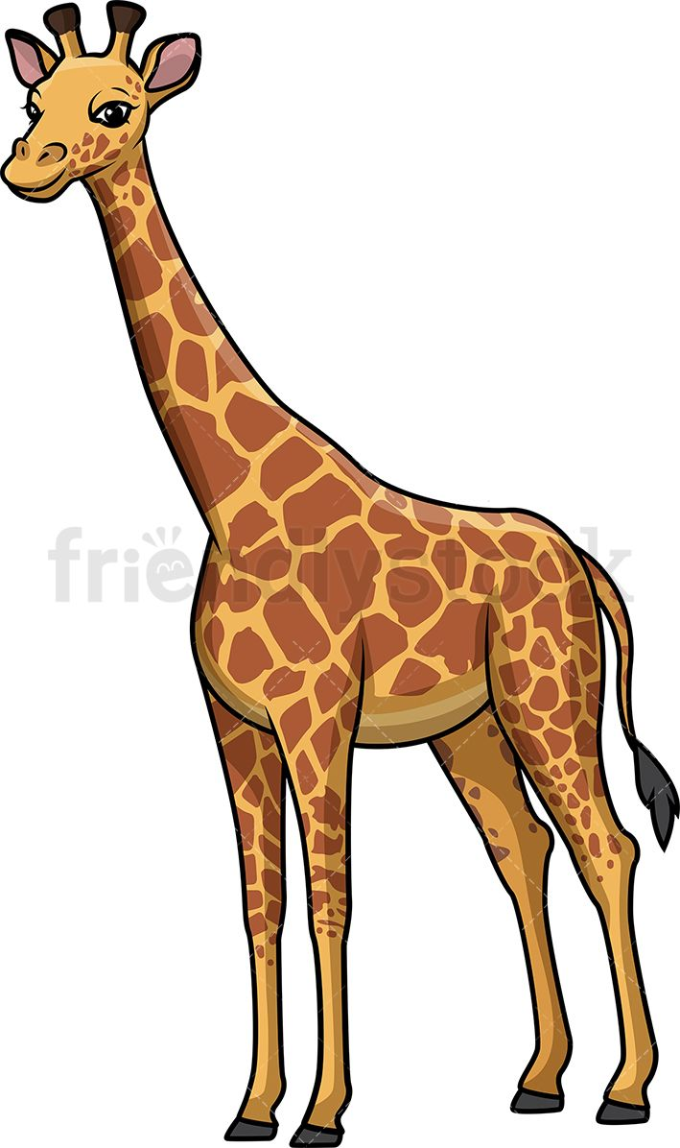
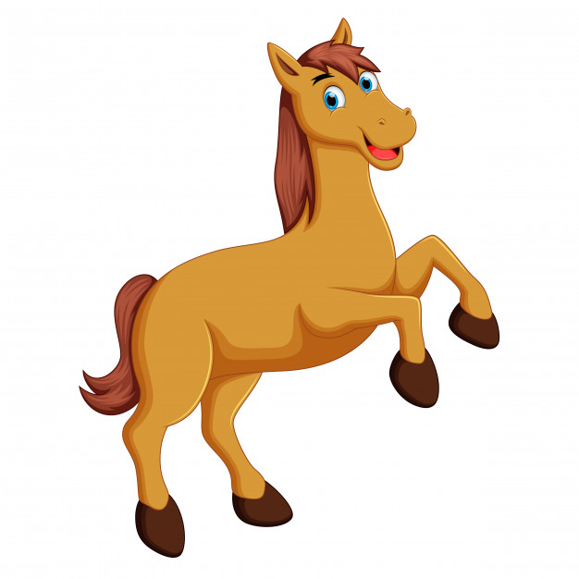
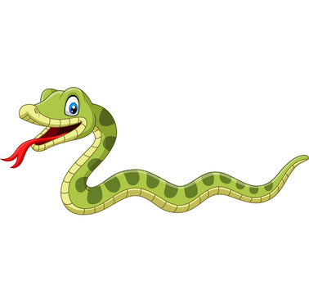
Worksheet
Match the words below with the correct picture:
Horse
snake
giraffe
Horse , snake, giraffe

Slide 6
Weather
https://www.youtube.com/watch?v=Z2biA1gczXs&ab_channel=LearningChocolate
Worksheet
https://www.liveworksheets.com/worksheets/en/English_as_a_Second_Language_(ESL)/Weather/What's_the_weather_like_today$_vk313886xg
Worksheet for animals
https://www.liveworksheets.com/worksheets/en/English_as_a_Second_Language_(ESL)/Animals/Animals_ot64176gy

